Slide 1

Capstone Project Airbnb Bookings Analysis by Bishakha Kumari Aashish Nitin Dubey

Slide 2
Content
About Airbnb
Agenda
Dataset Summary
Data Cleaning
Distinguishing Features
Correlation heatmap
Analysis of dataset
Conclusion
Tools Used

Slide 3


About Airbnb
Airbnb, Inc. is an American company that operates an online marketplace for lodging, primarily homestays for vacation rentals, and tourism activities. Based in San Francisco, California, the platform is accessible via website and mobile app. Airbnb does not own any of the listed properties; instead, it profits by receiving commission from each booking. The company was founded in 2008 by Brian Chesky, Nathan Blecharczyk and Joe Gebbia. Airbnb is a shortened version of its original name, AirBedandBreakfast.com.

Slide 4
Agenda
We will analyse the Airbnb dataset of New York City.
We will perform different analysis and try to gain insights like:
Which borough has more number of listings and the reason behind it.
The neighbourhood that is more popular
Room types that are preferred the most by guests
Review and ratings
By doing this we will try to find the factors affecting the Airbnb listings in New York City.

Slide 5
Dataset Summary
Our Airbnb dataset contains 16 features and below are the detailed description of all the features:
id and name - They are simply the listing id and their names
host_id and host_name - They signify the id of host who are associated to the respective listing and their names
neighbourhood_group - It contains the district of the listing.
neighbourhood - the neighborhood of the respective neighborhood groups.
latitude and longitude - the geographical co-ordinates of respective listings.
room_types - listing space type

Slide 6
Dataset Summary Continued…
price - price of listing in dollars
minimum_nights - amount of nights minimum
calculated_host_listings_count - amount of listing per host
availability_365 - number of days when listing is available for booking
number_of_reviews - Total number of reviews
reviews_per_month - average of reviews per month
last_review - date of the last review recorded

Slide 7


Data Cleaning
Cleaning of dataset is very important to get a relevant Information
out of it. Following are the process that we have followed to clean our
data:
We have determined the shape, columns and their data types of our dataset.
Eliminated the columns that are not needed in our analysis.
Determined the columns that have null values present in it and the null
Count.
Imputed the null values that has higher number of null count.
Deleted the records for the columns that has very low null count.

Slide 8
Distinguishing Features
The Airbnb dataset contains a mixture of numerical features and categorical features. Below is the distinguished view of the features that we have used in our analysis
Categorical Features
id
name
host_id
host_name
neighbourhood_group
neighbourhood
room_type
Numerical Features
Latitude
Longitude
Price
minimum_nights
calculated_host_listings_count
availability_365
number_of_reviews
reviews_per_month
Airbnb dataset
Data Types
Int
Float
Object

Slide 9
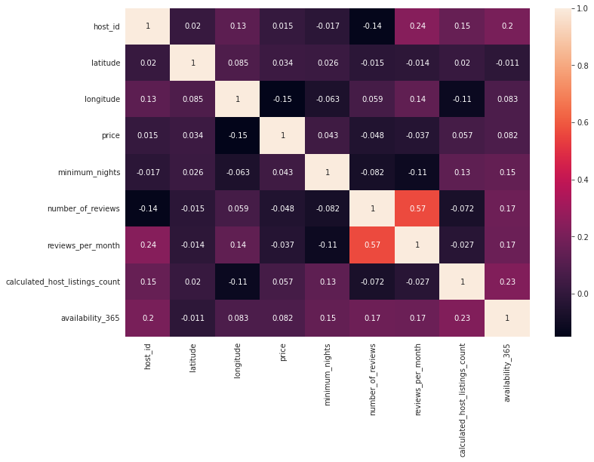
Correlation Heatmap
Observations :
There is a negative correlation between host_id and number_of reviews so we can say for a region where there are more number of hosts, the guests will have more option of booking that are available which will ultimately divides the number of reviews or, if the particular host have multiple Airbnb listings then he will have a lot to manage already, so he does not take proper reviews from their guests.
There is a negative correlation between longitude and price and mild positive correlation between latitude and price, so we can say that the areas towards north-west are more costly
There is a negative correlation between longitude and calculated_host_listings_count , depicts that areas towards west have more Airbnb listings.
price and number_of_reviews are negatively correlated to each other as lesser number of people will prefer the costly aboard
number_of_reviews and reviews_per_month have negative correlation with minimum_nights, we can conclude that guest prefers flexibility of check-out.

Slide 10

Analysis of Airbnb dataset
To get the information out of our dataset we have performed different kind of analysis. Following are the analysis that has been done:
Univariate Analysis
Bivariate Analysis
Busiest host according to occupancy rate
Location wise Traffic and reason behind it
We will discuss all of the above pointers in details in next pages.

Slide 11

Analysis of Airbnb dataset Continued…
Univariate Analysis
By doing univariate analysis we have found information about different features that are present in the dataset like host_id, neighbourhood_group, neighbourhood etc.
Moving to next page to show the analysis that is performed on individual features and the information that we got from it.

Slide 12
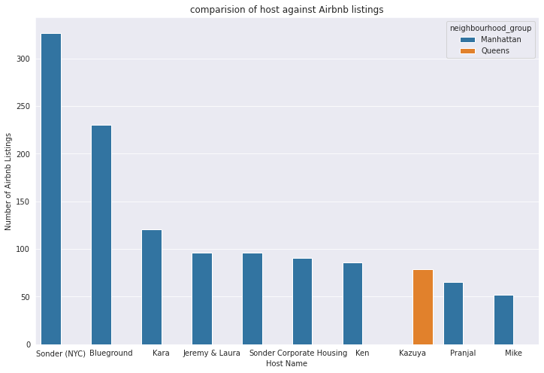
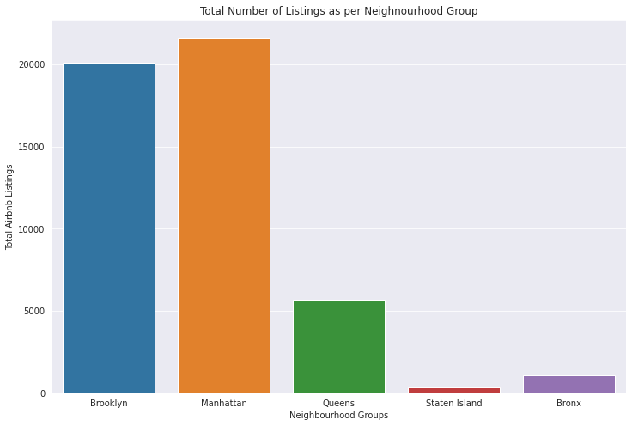
As we can see that Manhattan has maximum number of Airbnb listings and is very popular in there as most of host from Manhattan has multiple listings. On the other hand, Staten Island has least number of listings. This may be due to very less people know about Staten Island and also it is considered that Manhattan has 99% of attraction sites in NYC.
The top 10 host on the basis of Airbnb listings.
We can see from the bar chart that Sonder(NYC) has maximum number of Airbnb listings.
Also there are 9 hosts from Manhattan who is in top 10 host according to listing count.
The total number of Airbnb listing in different boroughs of NYC
Manhattan has the maximum number of listings.
Staten Island has the least number of Airbnb listing.

Slide 13
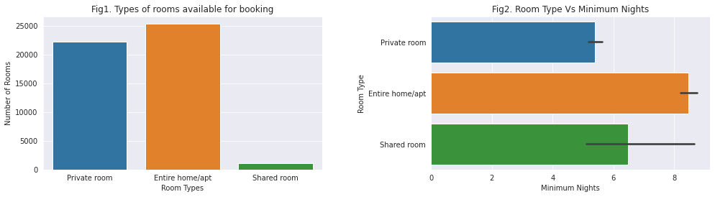
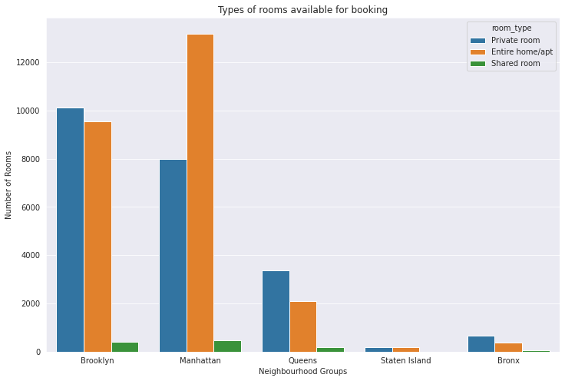
Number of different room types present in different boroughs
Figure shows the total number of rooms of different rooms available.
This figure shows that the listings with Entire home/apt are maximum in number
The shared listings are the least.
This figure shows the choices of rooms available in all the five boroughs of NYC.
Manhattan has maximum number of listings with Entire home/apt.
All the other 4 boroughs have almost equal number of Private rooms and Entire home/apt
The number of shared rooms are the least.
From both the graphs it can be conclude that shared rooms are least preferred by guests.

Slide 14

Analysis of Airbnb dataset Continued…
Bivariate Analysis
By doing bivariate analysis, we will try to establish relationships between features like:
Location and price – for which location prices are higher or lower
Locations and reviews – to see which location is receiving more number of reviews.
Number of reviews and price – to see the listing with which price range are getting more reviews.
Number of reviews and minimum nights – to see if number of reviews is dependent on minimum nights feature
Navigating to next pages to demonstrate above points.

Slide 15
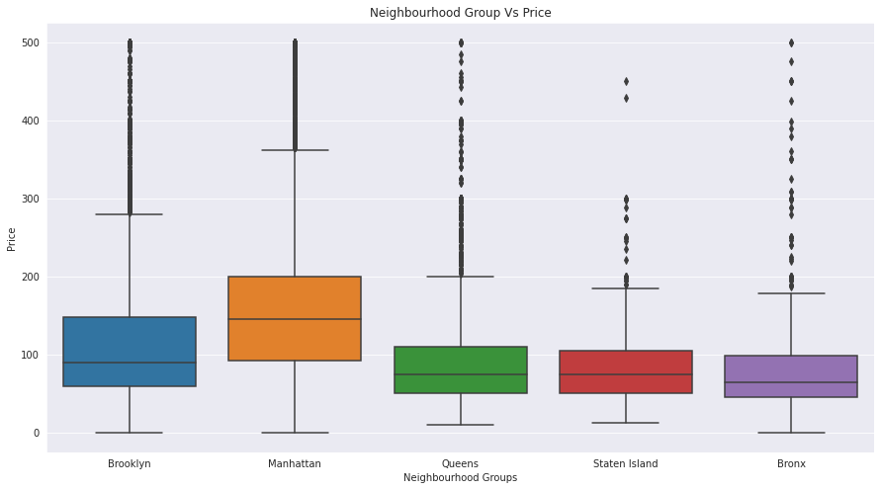
Location Vs Price
Below is box plot showing the five point summary of listing prices according to the different boroughs present. We have following observations from the plot:
Manhattan is the costliest among all the boroughs.
Bronx is the cheapest among all the boroughs.
The rest of the three boroughs namely, Brooklyn, Staten Island and Queens has more or less same price.

Slide 16
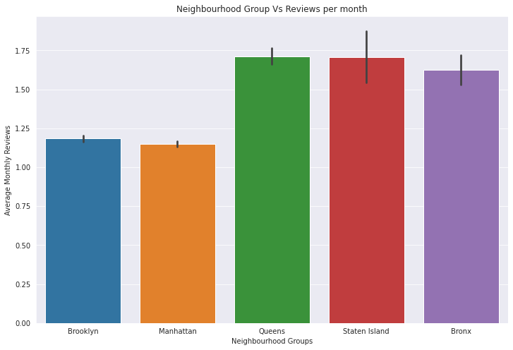
Location Vs Number of reviews
The bar graph showing the location vs number of reviews, through this graph we can visualize which location is getting more number of average reviews.
Observations from the bar chart:
The boroughs with less number of Airbnb listings namely, Staten Island, Bronx and Queens are getting more number of reviews.
The boroughs with maximum listings count i.e., Manhattan and Brooklyn are getting lesser reviews.
Possible reasons for this result could be any of the following:
The hosts of the locations which kas less number of listings has lesser number of listings associated to them, so they are able to cater to most of their guests and encourage them to give reviews
There may be more corporate bookings in Manhattan or the high profile people are visiting Manhattan, and they probably do not give reviews most often

Slide 17
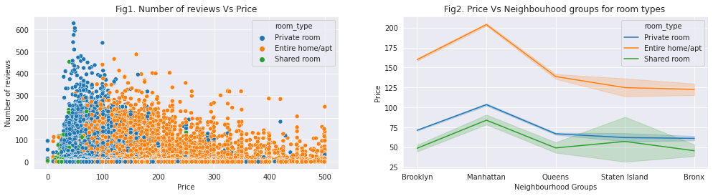
Price Vs Locations and Number of reviews
Fig 1. Number of reviews Vs Price
Fig1. shows the variation of number of reviews and price of different rooms types
Private rooms are getting more number of reviews as compared to other two categories, it may be due to the private room types are less costly so more people can afford it.
Fig 2. Price Vs Locations
Fig 2. shows the variation of price by locations of room types.
The listing offering Entire home/apt are generally costly than the other two. And from earlier graphs we have seen that Manhattan is the costliest, has maximum number of Entire home/apt and receiving lesser reviews which is valid.

Slide 18
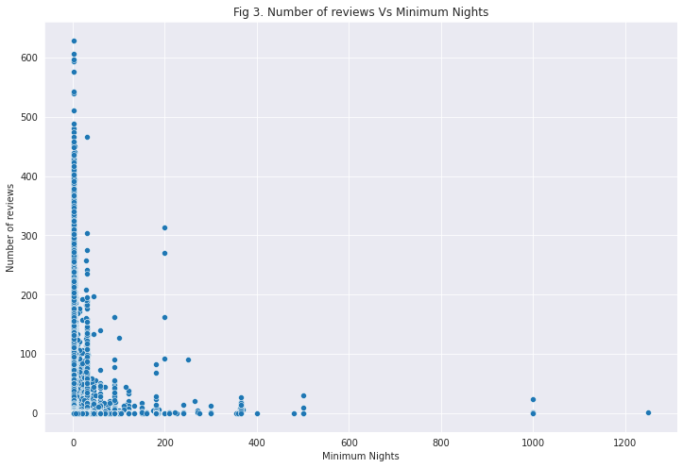
Minimum Nights Vs Number of reviews and Room Type
Fig 3. Minimum Nights Vs No. of reviews
Fig 3. shows the relation between minimum nights and number of reviews.
Here we can see that guest are preferring the listings that has less minimum nights. This may be due to the fact that most of the people are visiting for shorter duration.
Fig 4 Minimum Nights Vs Room Type
Fig 4. shows the comparison between minimum nights and room types.
Here we can see that the Entire home/apt and shared are rooms are generally preferred for longer duration.

Slide 19

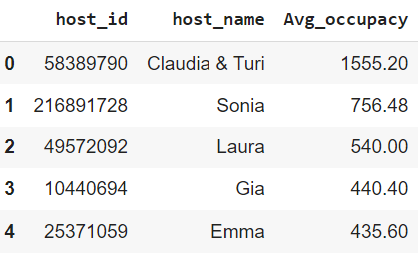
Analysis of Airbnb dataset Continued…
Busiest host according to occupancy rate
We have added a new column ‘occupancy’ to find out who
is the busiest host according to occupancy rate.
Occupancy Rate – It is defined as the percentage of days a listing is occupied in year(i.e. if all the available days are rented out, then the listing’s occupancy rate is 100%).
Formula for estimating Occupancy rate is as follows: occupancy = ((reviews per month * min. nights) * 12) / availability_365
From the output we can see that Claudia & Turi is the busiest host according to average of the occupancies of the listings associated to them.
Apart from this we can also get the name of the five busiest host:
Claudia & Turi
Sonia
Laura
Gia
Emma

Slide 20
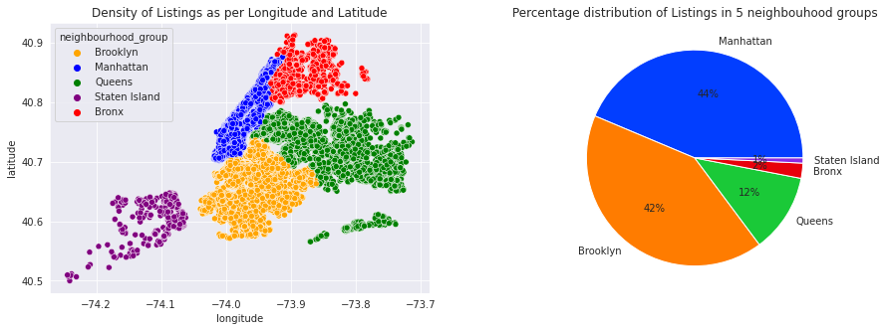
Analysis of Airbnb dataset Continued…
Location wise Traffic and reason behind it.
From the above two charts we can observe that Manhattan has the highest traffic among all five neighbourhood groups. Manhattan has more traffic probably because it is the most popular borough of NYC and considered to have most of very popular attractions. In fact, most people believe Manhattan to be the synonym of NYC. Brooklyn comes second on the basis of traffic as it is considered to be the second most famous district of New York after Manhattan. Staten island has least because this location is least known.

Slide 21
Conclusion
By exploring the Airbnb dataset we have drawn many out many information. Some of them are listed below:
Our Airbnb dataset has data from the five boroughs of NYC namely Manhattan, Brooklyn, Queens, Bronx and Staten Island
Manhattan has maximum number of listings, this may be the case because Manhattan has almost 99% of tourists attractions all over the NYC. Some of them are Empire State Building, the Rockefeller Center, the surprising Chrysler Building, the fascinating Times Square, the controversial MoMA etc.
Brooklyn has second highest listings and Staten Island has the least.
Most of the hosts from Manhattan has multiple number of listings.
Most of the guests visiting Manhattan and Brooklyn are not giving reviews, it may be because more corporate bookings are happening in Manhattan and Brooklyn or the high profile people are visiting these locations, and they probably do not give reviews most often.
The boroughs with less number of listings are receiving more reviews, the reason probably would be the hosts are able to cater to most of their guests and encouraging them to give reviews.
There are three categories of room types available which are: Entire home/apt, Private Rooms and Shared rooms. Out of these three Entire home/apt is very expensive and shared rooms are the least expensive.
Private rooms are mostly preferred over Entire home/apt because it is less costly and has less minimum nights dependency.

Slide 22
Tools Used
Google Colaboratory
Python
github
Libraries imported:
Pandas
Numpy
Matplotlib
Seaborn

Slide 23
Thank You

